Slide 1
Market-State-Conditioned Orchestration of Heterogeneous Agents for Financial Decision Support
6SENG010C · SOFTWARE ENGINEERING FINAL PROJECT · PROJECT PROPOSAL
How should the influence of methodologically unlike financial agents be set when the reliability of their evidence channels varies with market conditions? I design, implement and evaluate a market-state-conditioned orchestration operator on Colombo Stock Exchange data.
STUDENT
IIT / UOW ID
SUPERVISOR
ACADEMIC YEAR
Shaahid Fathul
20223216 · W1986734
Guhanathan Poravi
2026 to 2027
Notes:
Open on the question, not the technology. One line: four agents produce signals, something has to turn them into one decision, and in the systems I reviewed that combination is fixed at design time. The project is about the combination step, not about building a profitable trading application. Say the word "orchestration operator" once and move on.

Slide 2
A research spine and a software engineering spine, carried together
PROPOSAL STORYLINE
Research spine | Software engineering spine | Where it is
Agent reliability varies with market state; reviewed systems combine as though it does not | A pipeline that does not emit confident output from an empty channel | Slides 3, 9
59 reviewed papers, the six nearest systems contrasted clause by clause | Every requirement carries the paper or the measurement that forced it | Slides 4, 5, 6, 8, 10
One main question, two supporting, each answerable by a planned experiment | Four agents, one orchestrator, nine stated exclusions | Slides 6, 7, 10
Design science, controlled comparison, five arms, one ablation per state input | Five layers, point-in-time access, a verified data pipeline | Slides 11 to 15
An operator with a named lineage, plus evidence on whether it earns its place | Research prototype, no interface, three decisions changed by responsible practice | Slides 16 to 20
2
Notes:
This is the map, not a section to dwell on. Fifteen seconds: the left column is the inquiry, the right column is the build, and they are the same project seen twice. Point at the right-hand column and say that the examiners will see software engineering evidence for every research claim.

Slide 3
Influence over a shared decision is fixed at design time
PROBLEM AND GOAL
Four agents produce signals, and something must turn them into one decision. In the systems I reviewed that combination is set once and never moves, and in most of them there is no weight object at all to move.
Evidence of significance
Who is affected
Project goal
Expected outcomes
Three documented failures: a CSE study fixing a 3:1 split on an easier task’s score; an optimiser fed uncalibrated model-authored returns; a pool degrading 10.36 points through a fixed prompt.
The investment decision-maker acting on the output, the researcher running the comparison, and retail participants least able to absorb a cost a model assumed away.
Build the operator and produce attributable evidence on whether conditioning earns its place against fixed, static learned and performance-reactive weighting. Not on whether the system is profitable.
A pipeline where changing liquidity changes the weights, a five-arm comparison with ablation deltas, a CSE baseline set, and a stated position on confidence comparability.
3
Notes:
Lead with the sentence in the large type and pause. The three failures are the evidence that this is a real problem and not a tidy one I invented; name one of them, the 3:1 split, because it is on this market. Be explicit that profitability is not the acceptance test, because that is the first thing a panel assumes about a trading project.

Slide 4
Four lines of evidence, one gap they converge on
FROM EVIDENCE TO RESEARCH GAP
Evidence source | What it shows | Limitation or tension | Resulting gap
Academic literature, 59 papers | Heterogeneity is widely adopted; combination is treated as a solved detail | Several systems carry no weight object. Those that do weight assets, not influence | Influence is fixed at design time and adapts to nothing measured outside the agent
Existing systems | Four named systems each get one necessary clause right | The nearest neighbour in each direction is strong, so the contrast must be clause by clause | I have not found a system that combines all four clauses at once
Domain evidence, the CSE | Volume Granger-causes the index at p = 0.0041; macro variables reach nothing | Channels go empty for days, so equal trust across agents is false here | A setting where channel reliability genuinely varies, and can be measured
Forecasting literature | Feature-conditioned combination learns weights over a heterogeneous pool | Its features are properties of the series, computed once from history | A generalisation along one identified axis, stated as such
4
Notes:
Read the last column down, not the table across. The claim in row two is bounded on purpose: I say I have not found such a system in the literature I covered, not that none exists. If asked how the four clauses were decided, they come from the clause-by-clause contrast in the gap matrix, which is backup slide B2.

Slide 5
Three themes, and what each one forces on the design
CRITICAL LITERATURE LANDSCAPE
THEME 1 · THE MARKET
THEME 2 · COMBINATION
THEME 3 · EVALUATION
Thin trading is the condition here, not an edge case
Every necessary clause exists somewhere, in a different system
A strong minority evaluates well, and almost none can be rerun
Volatility clustering in three CSE studies, long memory across all three regimes, and illiquidity shocks depressing returns.
Analyst pipelines, feature-conditioned combination, continuous state conditioning, and explicit weight vectors over assets.
Walk-forward, regime decomposition and cost sweeps appear. Of my 59 papers, 4 are reproducible from the paper alone.
The conditioning variables are locally evidenced, not borrowed
The gap is the conjunction, so the contribution is a generalisation
Cached outputs across arms, a pre-registered margin, a released pipeline
5
Notes:
The tinted strip at the foot of each card is the point of the slide: each theme ends in a design consequence rather than a summary. If pressed on the 4 of 59 figure, say it is my own coding over my own corpus, the rule is written down, and it is why reproducibility is designed in rather than claimed.

Slide 6
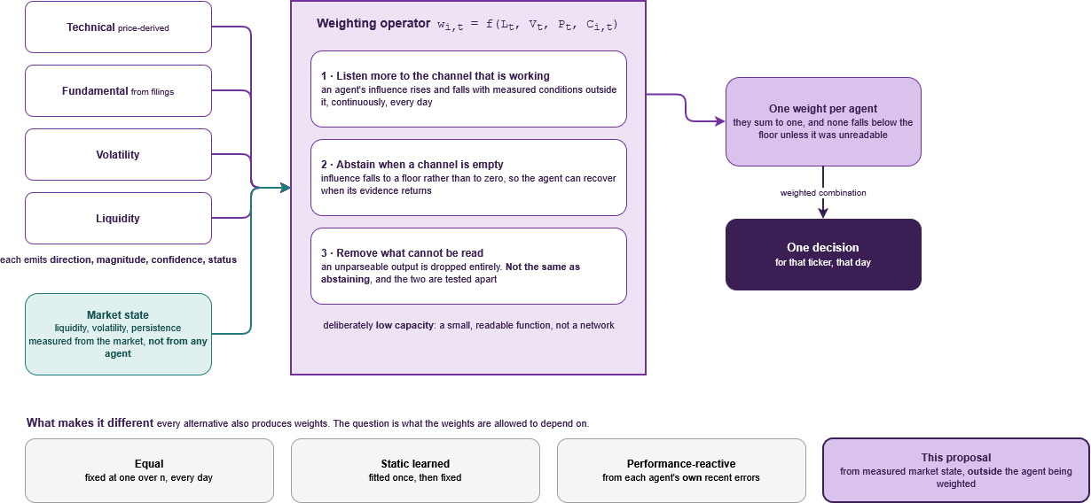
Every alternative also produces weights. The question is what the weights may depend on
GAP, NOVELTY AND CONTRIBUTION
WHAT EXISTS
Multi-agent systems that combine analysts, mostly through a prompt. Influence fixed at design time.
WHAT IS MISSING
A weight that depends on conditions measured outside the agent being weighted, recomputed every step.
THE CONTRIBUTION
Attributable evidence on whether state-aware orchestration earns its place, positioned as a generalisation of feature-conditioned combination along one named axis.
6
Notes:
This is the slide to slow down on. Walk the diagram left to right once: four unlike agents, a state vector measured from the market and not from any agent, one weighting operator, one decision. Then point at the four boxes along the bottom and say that the difference between them is only what the weights are allowed to depend on. The honest framing is a generalisation along one axis, not an unprecedented mechanism, and that framing is deliberate.

Slide 7
No question is answerable yes or no. Each asks how
QUESTIONS, OBJECTIVES AND SUCCESS CRITERIA
MAIN RESEARCH QUESTION
How should the influence of heterogeneous agents be adapted to measured market state, and under what conditions does adaptation earn its place?
Answered by five arms over byte-identical cached outputs, with one ablation per state input. Success: the median per-fold gain exceeds the interquartile range of the equal-weight arm across 16 folds and clears HAC and bootstrap tests at 0.05.
SUPPORTING QUESTION 1
SUPPORTING QUESTION 2
OBJECTIVES
How should the system alter execution and the influence of price-derived agents when liquidity deteriorates?
How can confidence from unlike architectures be placed on a common scale?
Build the artefact, then evaluate it honestly.
Data layer, four agents behind one contract, state vector, operator, five-arm harness. Acceptance criteria A1 to A6. A null at the pre-registered margin is acceptable, decided in advance.
Sensitivity sweep of weights against liquidity, with two ablations that separate trust from execution.
Four structural mechanisms, each mapped through its own accuracy-at-threshold curve. If they do not land in one unit, that is the finding.
Each question has a pre-specified response if the answer is unfavourable, written before any run.
7
Notes:
Say the main question aloud in full; it is the sentence the whole proposal hangs on. The margin rule is the thing a panel will press, so be ready: the comparator is equal weighting, the margin is that arm's own fold-to-fold dispersion, and the reason for using dispersion rather than a fixed percentage is that it scales with how noisy the folds actually are. Backup slide B4 has the full statement.

Slide 8
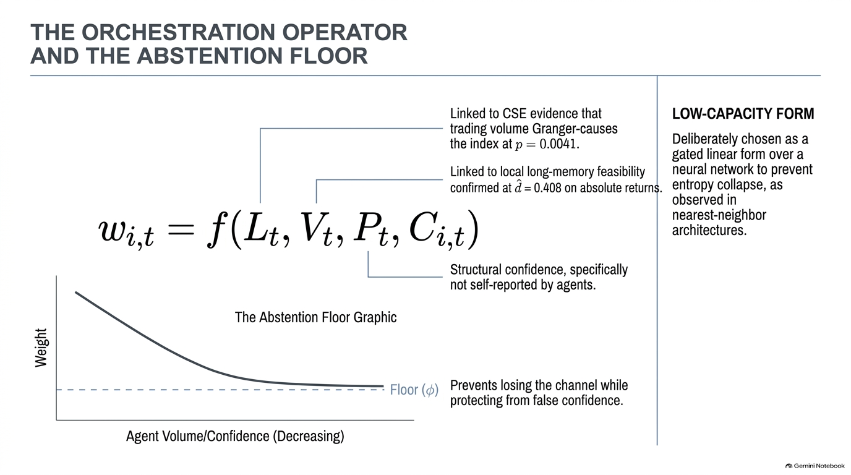

Slide 9
The nearest system in each direction gets one clause right
EXISTING SOLUTIONS AND BASELINES
System or baseline | What it gets right | Where it stops | What that forces on my design
Prompt-combined agent systems | Heterogeneous roles feeding one decision | They combine through free text, so no weight object exists | A common structured output contract has to come first. FR2
HedgeAgents | Optimisation over an explicit weight vector | The weights are over assets, so which method to trust cannot arise | The single-shared-decision clause, and calibration before any optimiser
MacroHFT | Continuous conditioning on market state, weight trace published | Six identical networks, so conditioning without heterogeneity | The heterogeneity clause, with entropy collapse as an observed failure mode
Feature-conditioned combination | Learned weights over a heterogeneous pool, closest in form | Features are properties of the series, computed once from history | Named as the lineage of this work rather than a rival
Pavithya et al. (2021), on the CSE | Two unlike models, one decision, on this market | A fixed 3:1 split taken from a score on an easier task | The motivating failure: a weight cannot come from an out-of-domain score
The proposal is compared against four alternatives over identical cached outputs, plus an oracle fitted on the test window held as a hindsight ceiling, not an achievable arm.
8
Notes:
Read the right-hand column, because it is what turns a literature table into requirements. The Pavithya row is the one to land on: it is on this exchange, it is the closest thing to this shape, and its weakness is exactly the thing I am proposing to fix. Be clear that the oracle is a hindsight upper bound used to size the gap, never a comparator I claim to reach.

Slide 10
Stakeholders
STAKEHOLDERS, USERS AND CONTEXT OF USE
PRIMARY OPERATOR · THE RESEARCHER
MOTIVATING BENEFICIARY · THE INVESTMENT DECISION-MAKER
Needs reproducible runs and comparisons that are actually fair.
Evidence: a published comparison gave its baseline less scaffolding than the proposed system. Design: byte-identical cached outputs across all five arms, enforced architecturally.
Needs a decision that does not carry confident influence from an empty channel.
Evidence: five documented cases of reliability varying unnoticed, including a 10.36-point loss. Design: the abstention channel and the confidence gate.
THE EXCHANGE AND ITS DATA REGIME
WIDER EXPOSURE · RETAIL PARTICIPANTS
Licensed data must be used within its terms.
Should not be exposed to a system that assumes away the cost they would pay.
Evidence: the purchased set carries 46 securities absent from the API, a 12.8 per cent gap. Design: official licensed extraction as the base panel, licence recorded per row.
Evidence: institutional ownership at 66.1 per cent against 5.7 per cent insider. Design: cost inside the allocation objective, and the artefact framed as a prototype rather than a recommender.
A well-formed directional signal produced from a channel that is empty today is the failure this system is designed to make visible.
9
Notes:
Each card runs need, evidence, design consequence, in that order, so say one of them that way in full and let the panel read the rest. The ownership figure supports a cautious reading only: concentrated holdings are consistent with thinner tradable depth, and I treat it as context for the cost assumption rather than as a measurement of depth.

Slide 11
Every requirement carries the evidence that forced it
REQUIREMENTS ENGINEERING
ID | Requirement | Type | Source or rationale | Acceptance evidence
FR1 | The data layer shall refuse any row past the simulation clock, raising rather than warning | Functional | Two documented point-in-time failures on this market | Cursor-violation test and an exception log
FR2 | Every agent shall emit the common output contract, all six fields | Functional | Prompt-combined systems in which no weight object exists | Contract conformance across all four agents
FR10a | The system shall emit the weight entropy series and the liquidity sensitivity | Functional | Acceptance criteria A2 and A3 are defined on these two quantities | Entropy series and sensitivity sweep plot
NFR7 | Outputs, state and weights shall be logged one row per ticker-date | Quality | An explanation that was not recorded is not an explanation | A sampled decision rebuilt end to end from the log
DR10 | Ex-date reliability shall be carried as a field, with inferred dates flagged | Data | No documented date in the registers is an ex-date; 259 are approximate | ex_date_basis populated; affected days flagged
B2 | No fifth agent, including a macroeconomic agent | Boundary | Rejected on evidence: adjusted R-squared 0.189 across five macro variables | Scope statement carrying the measurement
43 requirements: 11 functional, 7 non-functional, 10 data, 7 model and AI, 8 boundary. Exactly three are Should. Six shown here; the full traceability matrix is backup slide B3.
10
Notes:
The two right-hand columns are the ones that matter: nothing is here because it seemed sensible. B2 is the row to offer unprompted, because a rejected requirement with a number attached shows the scope was decided on evidence rather than on effort. If asked for the full 43, go to backup slide B3 rather than describing it.

Slide 12
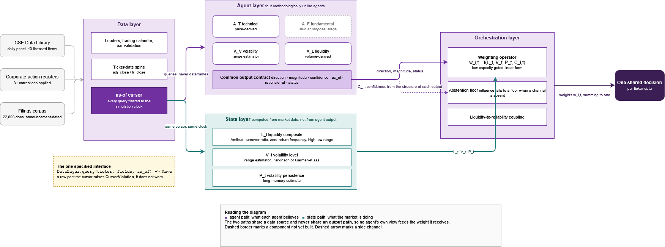
Five layers, one clock, and no agent feeding the weight it receives
INDICATIVE TECHNICAL SOLUTION
One interface is fully specified: DataLayer.query(ticker, fields, as_of) returns rows and raises CursorViolation. Python and the scientific stack; the model backbone stays open against four stated selection criteria.
11
Notes:
Trace two paths with a finger. The purple path is what each agent believes. The green path is what the market is doing. They share a data source and never share an output path, which is the structural reason no agent's own view can feed the weight it receives. Name the uncertainties rather than hiding them: whether four competence estimates can be made comparable is measured, not assumed; residual correlation between the liquidity agent and the liquidity state is reported; and whether the weights move at all is acceptance criterion A3, due eight days before the interim demonstration. The dashed box is the fundamental agent, which is a stub at proposal stage, and the deck says so.

Slide 13
Purchased, reconciled, and honest about the one gap
DATA AND EVIDENCE STRATEGY
Data need | Source and route | Quality check, and its status | Ethics and licence control
Price and volume panel | Official CSE Data Library, purchased. 355 core securities, 233 candidates, July 2012 to June 2026 | Verified: turnover reconciled at 0.13 per cent, 99.93 per cent close agreement against an independent archive | Licensed purchase, not scraping. Licence recorded per dataset row
Corporate actions | Data Library registers. Adjusted panel constructed 23 October, carrying adj_close and tr_close | Verified: applied per security per year, confirmed against the next year end. 31 corrections | Official registers rather than inferred adjustments
Liquidity inputs | Turnover, trade count, quarterly float and crossings, held across the full span | Verified: crossings run 8.8 to 47.4 per cent of annual turnover; stripped and unstripped both reported | Same licensed source
Filings corpus | 22,893 documents, January 2012 to October 2026, roughly 340 counters | Downloaded and probed, not yet validated for answerability. Every filename carries its announcement date | Exchange terms respected; retained for research, never redistributed
Not held: bid, ask, depth | Absent from all forty purchased items. An exchange request is the only route | The cost work runs on proxies, declared in advance as the plan rather than as a fallback | The released pipeline is code plus an acquisition route, never the data
The window is anchored to an index-regime boundary rather than to data availability: the S&P SL20 launched in June 2012, so the large-cap methodology is constant across the sample.
12
Notes:
Four statuses stay distinct and I say which applies: a source identified, a dataset downloaded, a derived dataset constructed, and that derived dataset validated. The first three rows are validated with numbers attached. The filings corpus is downloaded and probed on 22 files, which supports a scoped claim about text extraction and nothing about answerability. The last row is the honest one: the microstructure data does not exist in what I hold, so the cost claim is narrowed to proxy-based simulation with its limits stated.

Slide 14
Two methodologies, answering two different questions
RESEARCH AND DEVELOPMENT METHODOLOGY
Research design
Design science research. The artefact is the instrument of inquiry, not the deliverable.
How the knowledge claim is investigated
Development process
Evolutionary prototyping managed through stage gates. The prototype validates mechanism feasibility, not requirements.
How the artefact is built iteratively
Evaluation protocol
Rolling walk-forward: 1,250-day train, 125-day test, 16 folds, periodic refit. Five arms, regimes decomposed, costs swept.
How evidence is collected and interpreted
Validity controls
Point-in-time enforcement that raises rather than warns, identical outputs across arms, margin and test fixed before the run, and a null pre-registered as an acceptable result.
How bias and weak inference are reduced
Rolling windows rather than expanding ones, because the decision margin is scaled to fold-to-fold dispersion and an expanding window would shrink it artificially.
13
Notes:
Make the distinction explicitly, because the guide warns against it: agile is not a research methodology. Design science answers how the knowledge claim is investigated; evolutionary prototyping answers how the artefact gets built; the two are separate layers and both are needed. The bottom band is the one that earns the mark, so do not rush it.

Slide 15
Only the weighting function differs between arms
EXPERIMENTAL AND EVALUATION DESIGN
Element | Design
Comparators | Five arms over byte-identical cached outputs: equal weight as the pre-registered primary, static learned, inverse-MSE with no state, the proposal, and an oracle fitted on the test window as a hindsight ceiling
Metrics | Cost-adjusted return over the full window, abstained days held flat, with per-traded-day as a secondary diagnostic. Every directional row carries class balance and Matthews correlation
Protocol | Rolling walk-forward, 16 folds, five seeds with dispersion reported, decomposed across the Easter attacks, COVID and the 2022 crisis, with a cost sweep
Ablation | One ablation per state input, which is what makes the answer attributable. Plus the fundamental agent on and off, two separating ablations, and a stability sweep
Success criterion | The median per-fold gain over equal weighting must exceed that arm’s own interquartile range across the 16 folds, and clear HAC and bootstrap tests at 0.05. A null is acceptable
What this cannot support: accuracy alone says nothing about decisions; no live-trading claim, because slippage is simulated and unvalidated; nothing generalises beyond one market, window and universe.
14
Notes:
The headline is the design control: the agents run once, every arm reads the same cache, so any difference in result comes from the weighting function and nothing else. On the success criterion, be precise. The estimand is the per-fold difference in cost-adjusted return against equal weighting; the margin is the interquartile range of the equal-weight arm's own per-fold returns; the tests are a HAC-corrected t test and a block bootstrap at the 0.05 level; and all three were fixed before any run. Backup slide B4 carries the full statement, and I would rather be asked for it than paraphrase it.

Slide 16
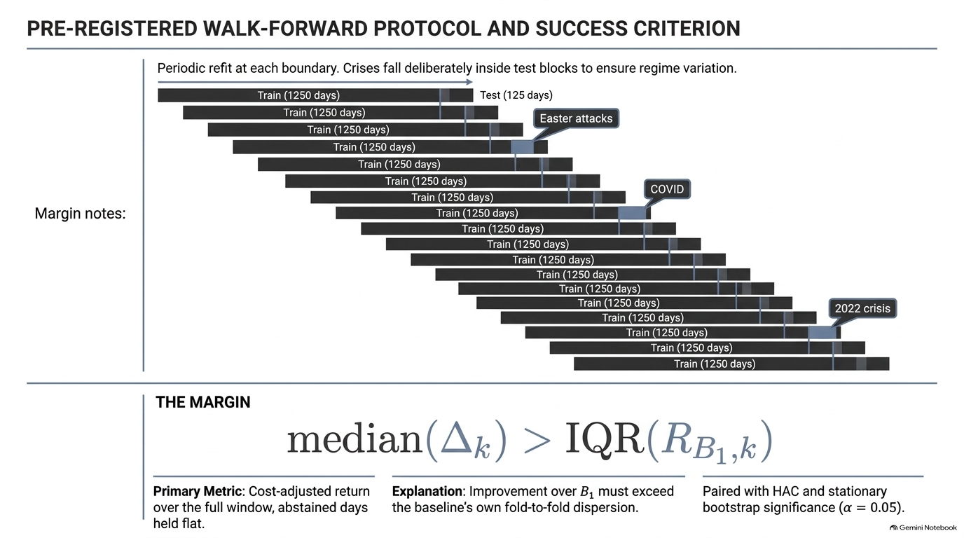

Slide 17
What runs today, and what is scheduled and says so
TESTING, QUALITY ASSURANCE AND TRACEABILITY
Area | Purpose | Evidence, and its status today
Unit and component | Verify isolated logic, estimators and the calibration transform | Planned, none exist today. Targets named and scheduled against the project stages
Integration | Verify end-to-end flow, and that every arm consumes the same cache | Planned. Acceptance criteria A1 and A5, through byte-identical output comparison across five arms
Requirements-based | Check each Must requirement is satisfied | Specified, not yet run. Nine named tests: cursor violation, contract conformance, state routing, simplex invariant, arm isolation, seed determinism, calibration, gating, result schema
Data and model checks | Detect leakage, bad data, drift and degenerate behaviour | Executed. Turnover reconciled at 0.13 per cent, 99.93 per cent archive agreement, 99.82 per cent of VWAPs in range, a validated 3,920-day calendar. These are the regression baselines
Behavioural diagnostics | Detect failures that make a correct-looking result meaningless | Designed. Weight entropy, liquidity sensitivity, agent error correlation, collinearity, weight trajectory, oracle gap, quiet against stressed
Usability, accessibility, security | Assess responsible use and quality constraints | Mostly not applicable, and said so. No interface, no accounts, no personal data. The real exposure is false confidence, tested functionally above
Coverage percentage is not reported: it counts lines executed, while the risk here is a correct-looking result produced from a wrong assumption.
15
Notes:
The bold word at the front of each cell is the slide. Four statuses, kept apart: executed, specified, designed, planned. Do not let an examiner leave thinking the test suite exists, because it does not, and saying so plainly is worth more than implying otherwise. The executed row is strong evidence and is worth one extra sentence: every data file examined so far has carried at least one defect, which is why the unexamined ones are named as unexamined.

Slide 18
Where a tool helped, and how each use was checked
ITERATION, FEEDBACK, CHANGE AND AI VERIFICATION
ITERATION AND FEEDBACK
CHANGE CONTROL
Weekly panel sessions and fortnightly supervisor meetings, recorded and transcribed. Every point splits into four things that cannot merge: the quote, my reading labelled as mine, the action, the status. Silence is recorded as unanswered, never as approval.
Four mechanisms in use: a dated freeze, dated revision headers, corrections marked in place, and superseded text retained beneath rather than deleted. Four worked examples, including one where the correction weakened my own argument.
Activity | Division of labour, and how it was verified | Evidence retained
Reviewing 59 papers | Every paper read, every note written against the source. What each paper claims and where it is weak is my reading, labelled as mine. The paper wins any conflict | 59 notes, the validation prompt, claim and evidence and reading kept separate
Building the matrices | Moving 1,621 quoted spans is transcription at scale, which is where a tool earns its place and exactly why it cannot be trusted unchecked. The audit is the point | 101 spans unquoted, 174 marks moved, all 1,621 traced back to a note
Deriving the weighting form | Term by term mapping to the papers supporting each term, with my own reasoning flagged as mine | Four terms mapped. The confidence term is named as the thinnest
Orchestration code | Stated intention, not practice. That code does not exist yet, so nothing about it has been verified | None yet, and this slide says so rather than implying otherwise
The data pipeline is verified by external reconciliation rather than inspection: against published annual data and against an independent archive.
16
Notes:
The last row is deliberate and is the one to point at. Thirteen corrections were found across the 59 notes by cross-checking synthesis back against the sources, and four were adjudicated against the original PDFs; one of those had reversed a paper's own ablation finding. If an examiner asks for the audit trail behind the 1,621 spans or the thirteen corrections, it exists in the vault and I would rather show it than describe it.

Slide 19
Five stages, each gated by the thing it cannot start without
PROJECT PLAN, MILESTONES AND DEPENDENCIES
Now to 5 Nov 2026
PP to IPD, 28 Jan 2027
IPD to feature complete
Testing and evaluation
Report, to 1 Apr 2027
Close the SE spine
Data layer and agents
Full build
Five arms at full scale
Analysis and thesis
Reconcile data counts, build and rehearse the presentation.
Liquidity profiling, the four agents behind one contract, the orchestrator.
Integration, the cost term inside the objective, the persistence experiment.
Ablations, regimes, significance tests and stability sweeps.
Limitations, write-up and the demonstration.
Thesis, artefact and code, reproducible from a clean environment
Submitted slides and the signed Ethics Application
Evaluation results and the CSE baseline set
Working prototype. Every Must requirement has a test that runs
Feature-complete artefact, no Must requirement untested
Fifteen per cent of each stage is held unallocated against failed experiments and data correction: 43 of 288 hours to the interim demonstration, 32 of 216 after it. Droppability is declared in advance, the persistence experiment first, the orchestration build never.
The hard dependency: the as-of cursor is built before any agent, because it cannot be retrofitted. Implementation is set aside by supervisor instruction until after submission.
17
Notes:
The tinted strip on each card is the milestone, so the plan is read as a chain of checkable outputs rather than as a wish. Two things make it credible rather than optimistic: the contingency is a number, not a sentence, and the drop order was decided before any pressure arrived. If asked what happens if the schedule slips, the answer is already written down: the persistence experiment goes first.

Slide 20
The two largest risks threaten the result, not the build
RISK, MITIGATION AND CONTINGENCY
Risk | Likelihood, impact, owner | Mitigation | Contingency
Equal weighting wins | High, high. P1 critical. Mine | Equal weight is the pre-registered benchmark, with the margin fixed before the run | A null is acceptable, decided in advance and reportable
State conditioning adds nothing beyond reacting to recent agent performance | Moderate, high. P2. Mine | The inverse-MSE arm exists specifically to detect this | If that arm matches, performance reactivity suffices here, which is a finding
No documented date in the registers is an ex-date | Certain, moderate. P2. Mine | Reliability carried as a field, 259 events marked approximate | Daily-return models drop or flag those days, and the count is reported
Bid, ask and depth never arrive | High, moderate. P2. Owner: the exchange | Two data levels declared in advance, before either request was made | The proxy route is the plan, and is guaranteed feasible
Available hours overestimated | Moderate, high. P2. Mine | Hour budgets per increment, with fifteen per cent held as reserve | A declared drop order. The build has already been re-cut once
Lookahead enters the pipeline | Low, high. P2. Mine | The as-of cursor raises rather than warns, and is built before any agent | Not retrofittable, which is why it is protected absolutely
Thirty-four scored rows across research, data, technical, schedule and evaluation risk, each with likelihood, impact, priority and owner. Six shown. Three risks are not mine to control, which is the point of the owner column.
18
Notes:
Lead with the first row, because a panel expects a student to hide it: the most likely outcome is that equal weighting is not beaten, and that outcome was made reportable in advance rather than defended against. The owner column is the second point. Two of these risks sit with the exchange, not with me, and naming that is what separates a risk register from a list of worries.

Slide 21
Three decisions that responsible practice actually changed
RESPONSIBLE RESEARCH AND PROJECT CONSIDERATIONS
Area | The issue, specific to this project | Decision taken
Ethics and participants | No human participants, no personal data, no primary collection | Removing sentiment removed the whole exposure: platform terms, annotation and redistribution went with it
Legal, IP, data protection | Licensed exchange data, and benchmark sets with differing licences | Purchased rather than scraped, licence recorded per dataset row. The released pipeline is code and an acquisition route, never the data
Security and safety | Not confidentiality. False confidence: a well-formed signal from an empty channel | A prototype, not advice. Abstention and calibration reduce this and do not remove it, because both fail towards overconfidence
Accessibility and EDI | No interface, so no interface surface. What applies is representational | The universe is stratified rather than selected from the top, and the count the screen removes is reported as a statistic
Sustainability and professional practice | Compute cost, and the obligation not to overclaim | Low-capacity form, no reinforcement learning, one agent pass serving five arms. Withdrawn claims recorded, nulls reported
Sentiment removed, which removed the participant exposure. A measurement rejected because its output could not be checked, costing half a sub-gap. Data purchased rather than scraped.
19
Notes:
This is the only slide carrying a whole criterion on its own, so give it the time. The test a marker applies is whether responsible considerations changed a decision or merely described one, which is why the footer names three that changed. The EDI line is the weakest and I would rather say so: with no interface, the applicable reading is representational, about which securities the liquidity screen removes, and that count is reported rather than hidden.

Slide 22
Substantial, bounded, and clear about what it cannot claim
SCOPE, LIMITATIONS AND CLOSING DEFENCE
SUBSTANTIAL SE WORK
FEASIBLE BOUNDARIES
WHAT SURVIVES EITHER RESULT
A point-in-time data layer over a market with no clean panel: five registers joined through a name crosswalk, ten source items changing meaning midway. An evaluation harness, not a backtest.
Nine exclusions, each with a reason: sentiment, any fifth agent, microstructure execution, a spread estimator, a network orchestrator, a user interface, and profitability as an acceptance test.
Whether confidence can be made comparable across unlike architectures, a measured cost-curve shape, and a worked case of how to read combination weights.
CLOSING DEFENCE
This project addresses how the influence of heterogeneous agents should be set over one shared decision when the reliability of their evidence channels varies with market conditions.
It is needed because in the systems I reviewed that influence is fixed at design time, and in most there is no weight object at all, while five documented cases show reliability varying unnoticed.
The scope is credible because boundaries are stated with reasons, the hardest benchmark is pre-registered, a null is acceptable in advance, and both live data risks had fallbacks declared before either one bit.
20
Notes:
Close on the dark band and say the three sentences as written, slowly. Do not add a flourish at the end. If there is time for one more line, it is this: the project is designed so that a negative result is still a result, and that was decided before any data was run rather than after.

Slide 23
Sources behind the claims on these slides
REFERENCES
Ardia, D., Guidotti, E. and Kroencke, T.A. (2024) ‘Efficient estimation of bid-ask spreads from open, high, low, and close prices’, Journal of Financial Economics, 161, 103916.
Mohamed Riyath, M.I. (2026) ‘Modeling long-term volatility memory dynamics in the Colombo Stock Exchange’, IIM Ranchi Journal of Management Studies, 5(1), pp. 21-45.
Dissanayake, M.B., Rathnayake, S.S. and Panditharathna, K.M. (2026) ‘The relationship between macroeconomic variables, trading volume and stock returns: Granger causality evidence from the Colombo Stock Exchange’, Journal of Business and Technology, 10(1), pp. 120-135.
Pavithya, M.B.D., Perera, G.S.D., Munasinghe, S.L. and Karunarathna, S.N. (2021) ‘Quantitative analysis and sentiment analysis for stock price forecast: the case of Colombo Stock Exchange’, 10th International Conference on Information and Automation for Sustainability, pp. 512-517.
Dissnayake, D.M.T.R. and Nanayakkara, N.S. (2025) ‘Role of market liquidity in sentiment-based return predictions: evidence from Sri Lanka’, International Journal of Economics and Financial Issues, 15(2), pp. 201-210.
Samarawickrama, I.D.W. and Pallegedara, A. (2023) ‘Sri Lankan stock market volatility analysis: an ARMA-GARCH approach’, Sri Lankan Journal of Business Economics, 12(1).
Wang, X., Hyndman, R.J., Li, F. and Kang, Y. (2023) ‘Forecast combinations: an over 50-year review’, International Journal of Forecasting, 39(4), pp. 1518-1547.
Fernando, A.D., Nimal, P.D. and Abeysekera, A. (2026) ‘Relationship between firm-level investment, idiosyncratic risk and ownership: an emerging market perspective’, Managerial Finance, 52(3), pp. 517-539.
Xiao, Y., Sun, E., Luo, D. and Wang, W. (2025) TradingAgents: multi-agents LLM financial trading framework. arXiv preprint arXiv:2412.20138.
Gibbs, I. and Candès, E. (2021) Adaptive conformal inference under distribution shift. arXiv preprint.
Zong, C., Wang, C., Qin, M., Feng, L., Wang, X. and An, B. (2024) ‘MacroHFT: memory augmented context-aware reinforcement learning on high frequency trading’, Proceedings of the 30th ACM SIGKDD Conference on Knowledge Discovery and Data Mining, pp. 4712-4721.
Li, X., Zeng, Y., Xing, X., Xu, J. and Xu, X. (2025) ‘HedgeAgents: a balanced-aware multi-agent financial trading system’, Companion Proceedings of the ACM Web Conference 2025, pp. 296-305.
Twelve of 59 reviewed sources, selected as the ones carrying claims on these slides. The full list, the CSE Data Library items cited item by item, and the pinned library versions are in the submitted reference list.
21
Notes:
Do not read this slide. One sentence only: Westminster Harvard throughout, every source-derived number cited at the point of use, and every number on the slides belongs to exactly one of five labelled categories: measured by me, reported by a tool, proposed as a threshold, read from a paper, or counted over my own corpus. The third category is the one most at risk of being read as a finding, so it is labelled wherever it appears. AI is not cited as evidence anywhere.

Slide 24
Evidence held ready, and what each piece defends
BACKUP AND QUESTION SUPPORT
B1 · The weighting operator, term by term
B2 · End-to-end pipeline and verification status
Four terms, each mapped to the paper supporting it, with my own reasoning flagged. A panel member has already asked this.
Defends feasibility, and separates what is done from what is designed and not yet built.
B3 · Requirements traceability
B4 · Arms, margin and the decision rule
The chain from source to requirement to test to evidence, across all 43 requirements.
Defends the evaluation design, the oracle as a ceiling, and the interquartile decision rule in full.
Also held: the literature and gap matrix
Also held: dataset construction and reconciliation
The clause-by-clause contrast against six named systems, and the coding rule behind every count quoted.
The reconciliation figures are the persuasive part. Plus the sentiment exclusion defence and the full reference list.
Three questions have no good answer yet, and they are named as such rather than deflected.
22
Notes:
Do not present this slide. It exists so that when a question lands, I can go straight to the slide that answers it rather than describing evidence the examiners cannot see. The three questions without good answers: whether cross-agent confidence can be put on one validated scale, what the primary estimand is if the interquartile rule is rejected, and whether the fundamental agent's filings corpus can answer numerically demanding questions at all.

Slide 25
Four conditioning terms, each attributed, one flagged as mine
BACKUP B1 · THE WEIGHTING OPERATOR, TERM BY TERM
w_i,t = f( L_t , V_t , P_t , C_i,t )
A low-capacity gated linear form, not a network. Weights are non-negative and sum to one, and none falls below the abstention floor unless its channel was unreadable. The conditioning set is provisional, not settled.
L_t
V_t
P_t
C_i,t
Liquidity composite
Volatility level
Volatility persistence
Agent confidence
Amihud illiquidity, turnover ratio, zero-return frequency and the high-low range, computed from market data. Recipe attributed to the microstructure literature.
A range estimator, Parkinson or Garman-Klass. Chosen over a GARCH fit because it needs no in-sample estimation at each step.
A long-memory estimate. Included because long memory is measured locally on this exchange across all three regimes, not assumed from elsewhere.
The thinnest term, and named as mine. Four unlike architectures produce confidence differently. Comparability is the subject of SQ2, mapped through accuracy-at-threshold curves, with conformal calibration as the fallback.
The state vector is computed from market data and never from agent output, so no agent’s own view can feed the weight it receives. That separation is architectural, not a convention.
Notes:
If asked why the form is linear and gated rather than learned: capacity was deliberately constrained so that the weights can be read. An observed sign flip under a small change in regularisation is the argument against a higher-capacity form, because a weight that flips sign under a tuning change cannot be interpreted as trust.

Slide 26
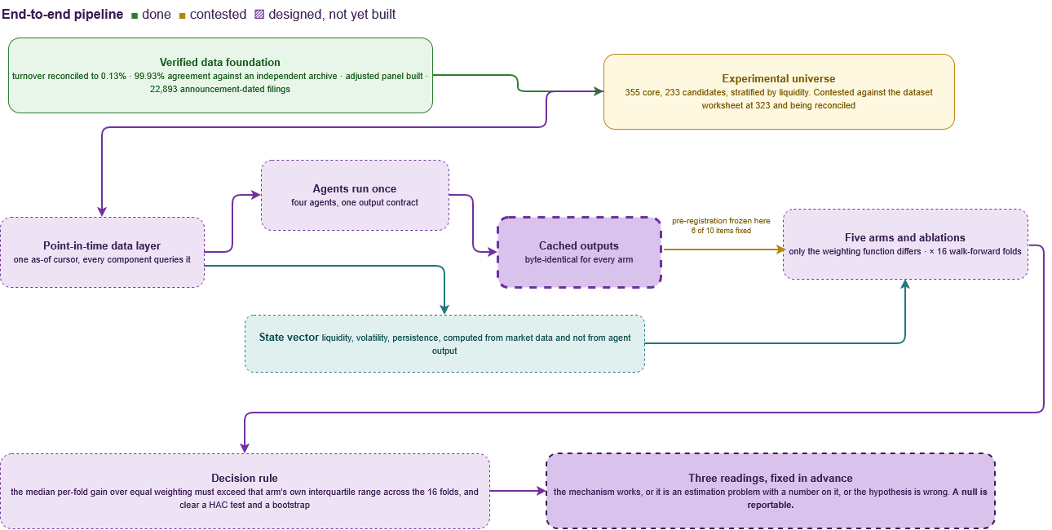
Done, contested, and designed but not yet built
BACKUP B2 · END-TO-END PIPELINE AND VERIFICATION STATUS
Notes:
The colour coding is the honesty of this slide. Green is verified with numbers attached. Amber is the one contested item, the experimental universe, where the deck says 355 and a dataset worksheet says 323 including 17 rights-issue securities, and the reconciliation into one defined raw, cleaned and eligible universe is in progress rather than finished. Hatched purple is designed and not yet built, which covers the cached outputs, the arms and the three readings. If asked whether anything has been run end to end, the answer is no, and the diagram says so rather than implying otherwise.

Slide 27
43 requirements, and the chain each one sits in
BACKUP B3 · REQUIREMENTS TRACEABILITY
11
7
10
7
8
3
Functional
Non-functional
Data
Model and AI
Boundary
Should, and only three
THE TRACE CHAIN, HELD FOR EVERY ROW
THE NINE NAMED REQUIREMENTS-BASED TESTS
Source evidence, the paper or the measurement that forced it, then the requirement, then the acceptance evidence, then the test that produces that evidence, then the research question it serves.
Cursor violation · contract conformance · state routing · simplex invariant · arm isolation · seed determinism · calibration · gating · result schema
Specified, not yet run. Scheduled against the stages on slide 17.
A requirement with no source is not in the set. A requirement with no acceptance evidence is not a Must.
Three Shoulds only: FR9, FR10b and MAI7. Everything else is a Must or a stated Boundary, which is what keeps the scope defensible under pressure.
Notes:
The point of this slide is that the requirement set is small, evidenced and prioritised rather than long. If asked to walk a row end to end, use B2 from slide 10: two documented point-in-time failures forced FR1, FR1's acceptance evidence is the cursor-violation test and an exception log, and that test serves the validity control on slide 13.

Slide 28
Five arms, and what each one is there to rule out
BACKUP B4 · ARMS, MARGIN AND THE DECISION RULE
Arm | What the weights depend on | What it rules out, or establishes
Equal weight · pre-registered primary | Nothing. One over n, every day | The hardest benchmark in the forecasting literature. If this wins, that is the reported result
Static learned | Fitted once on the training fold, then fixed | Whether any differentiation helps at all, before adaptation is considered
Inverse-MSE | Each agent’s own recent errors. No market state | Whether exogenous state adds anything beyond reacting to recent performance. The sharpest rival
The proposal | Liquidity, volatility, persistence and confidence, measured outside the agent | The claim under test
Oracle · hindsight ceiling | Fitted on the test window itself | Not achievable, and not a comparator. It sizes how much headroom any weighting scheme could have had
THE DECISION RULE, FIXED BEFORE ANY RUN
Estimand: the per-fold difference in cost-adjusted return against equal weighting, abstained days held flat, across 16 rolling walk-forward folds. Margin: the median difference must exceed the interquartile range of the equal-weight arm’s own per-fold returns. Tests: a HAC-corrected t test and a block bootstrap, both at 0.05. Only the weighting function differs between arms, because every arm reads the same byte-identical cache.
The margin is scaled to dispersion rather than set as a fixed percentage, so that a gain is only called a gain when it is larger than the fold-to-fold noise it has to be read against.
Notes:
This is the slide for the statistics question, and it will be asked. The known weakness is that an interquartile range is a dispersion measure rather than a distributional claim, and that was raised in review on 24 October. The defensible position is that the rule is a pre-registered, conservative decision threshold rather than a significance test, and the two significance tests sit beside it rather than being replaced by it. If pressed further, say that tightening this into a single coherent estimand with a stated test and decision rule is open work, and give the date it is due.

